Slide 1
Arduino Final Project
Access control system
By Zora & Jada

Slide 2
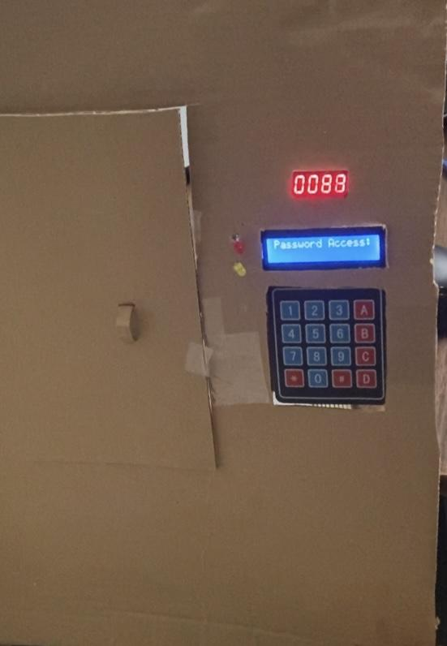
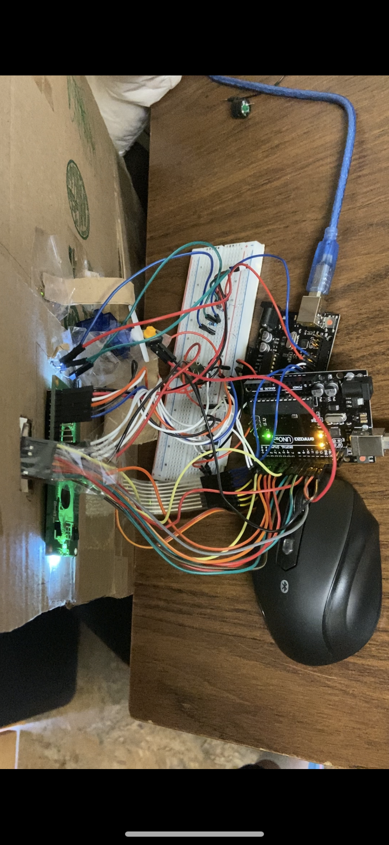
What is it?
It’s an access control system, which you can open the door by entering the correct password. And the door will automatically closed within 8.8 second. The process of counting down is displayed in the countdown timer.

Slide 3
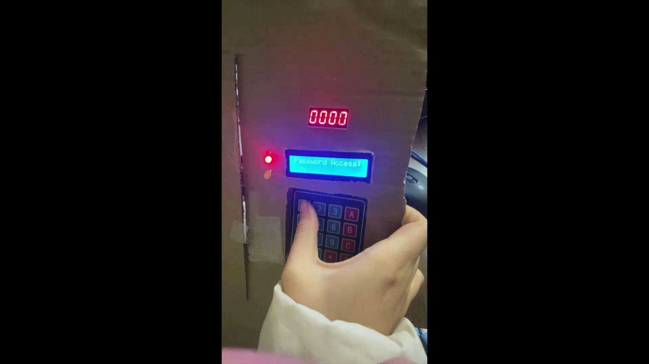

How does it work

Slide 4
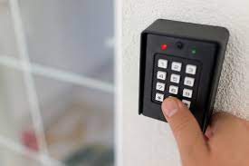
Where did the idea came from?
The idea of the access control system came from the daily life because it is used widely in buildings and households to ensure the security.
Also, it would be a comprehensive project since it combines perfectly with both the software and hardware, and it is possible to use the components much as LCD, LED and Servo, which we already accumulate some experience on.

Slide 5
What did we borrow
-1 LCD
-1 Bread board
-1 Keypad
-2 Arduino control board
-1 4 digit 7 segment display
-Wires
-2 USB cable
-1 Button
-1Servo
-2 Resistor
-1 Potentiometer
-2 LED

Slide 6
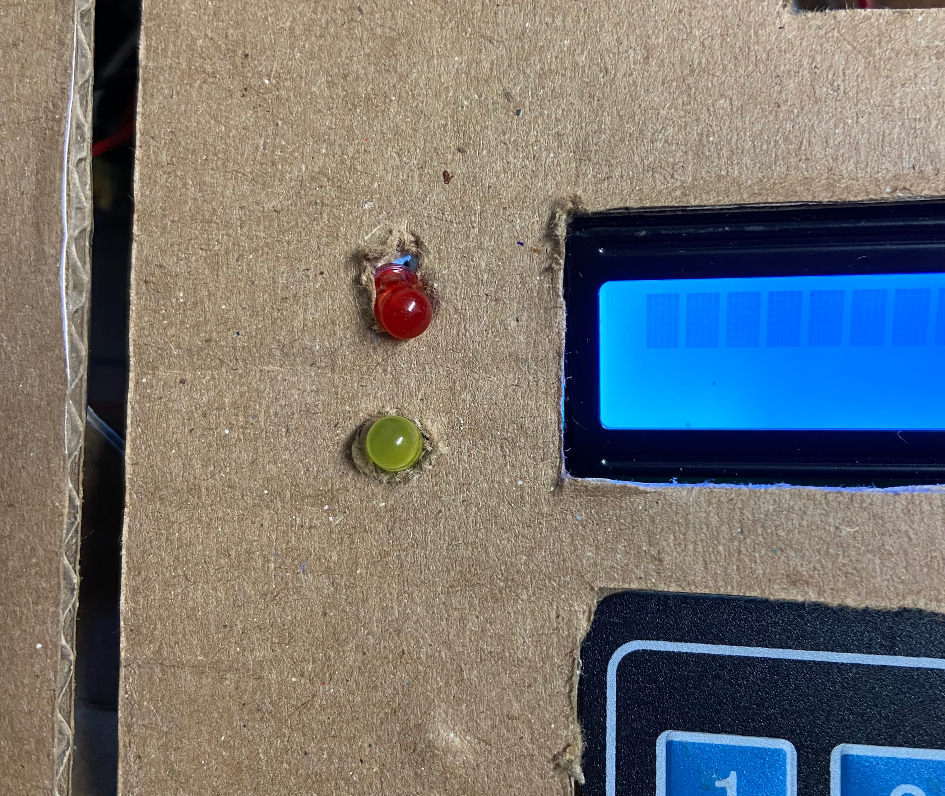
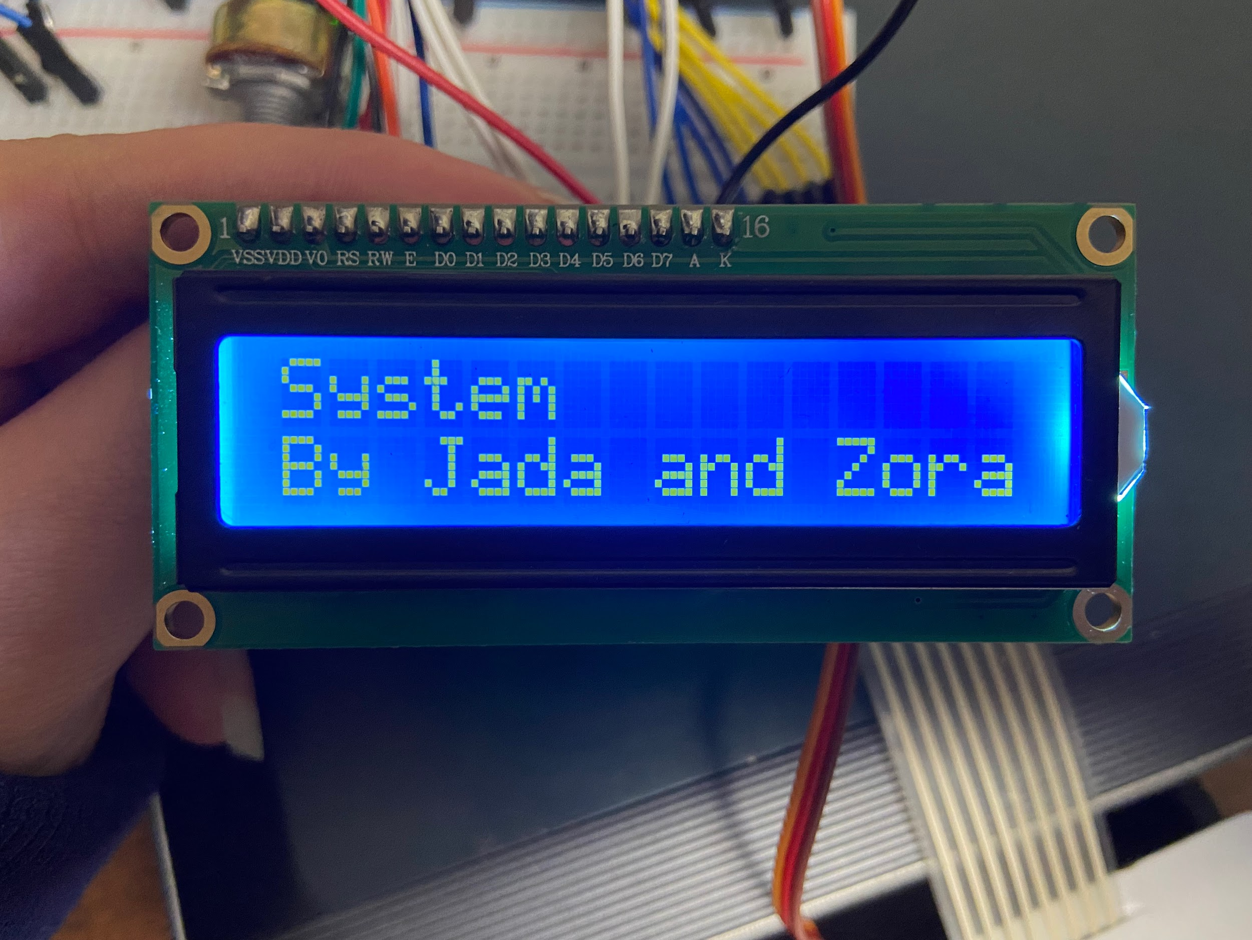
What role did the components play in the system
LED - signal display (whether the password is right or wrong)
LCD- message display (The text,the state of the door and whether the password is right or wrong)

Slide 7
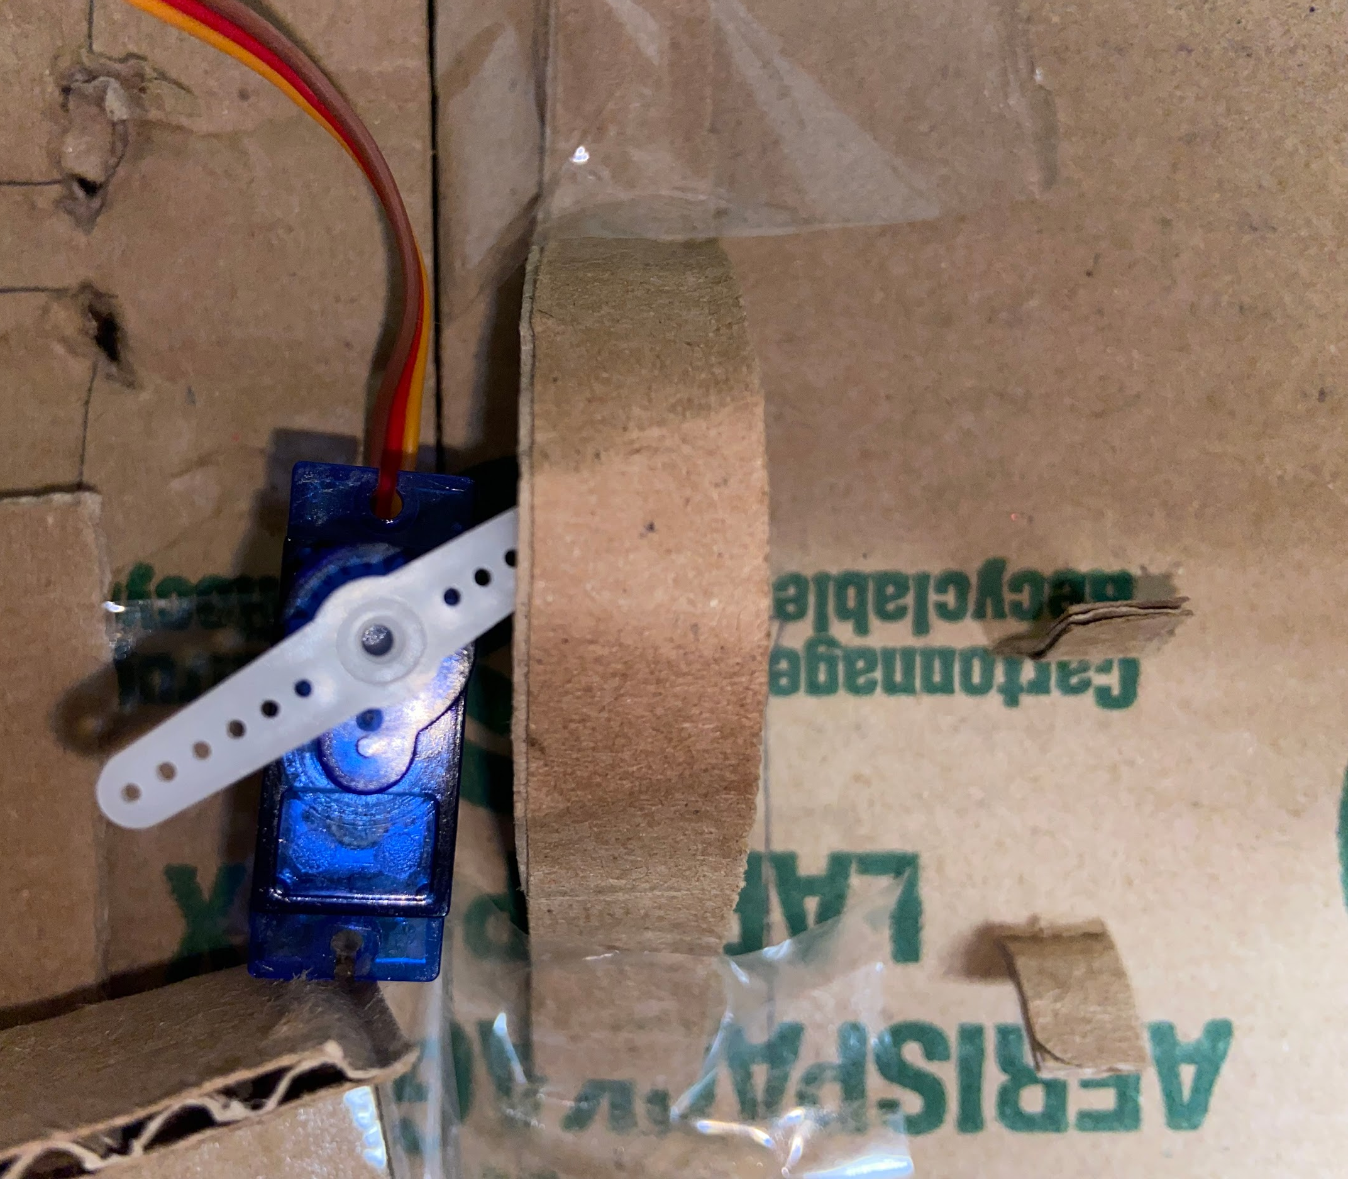
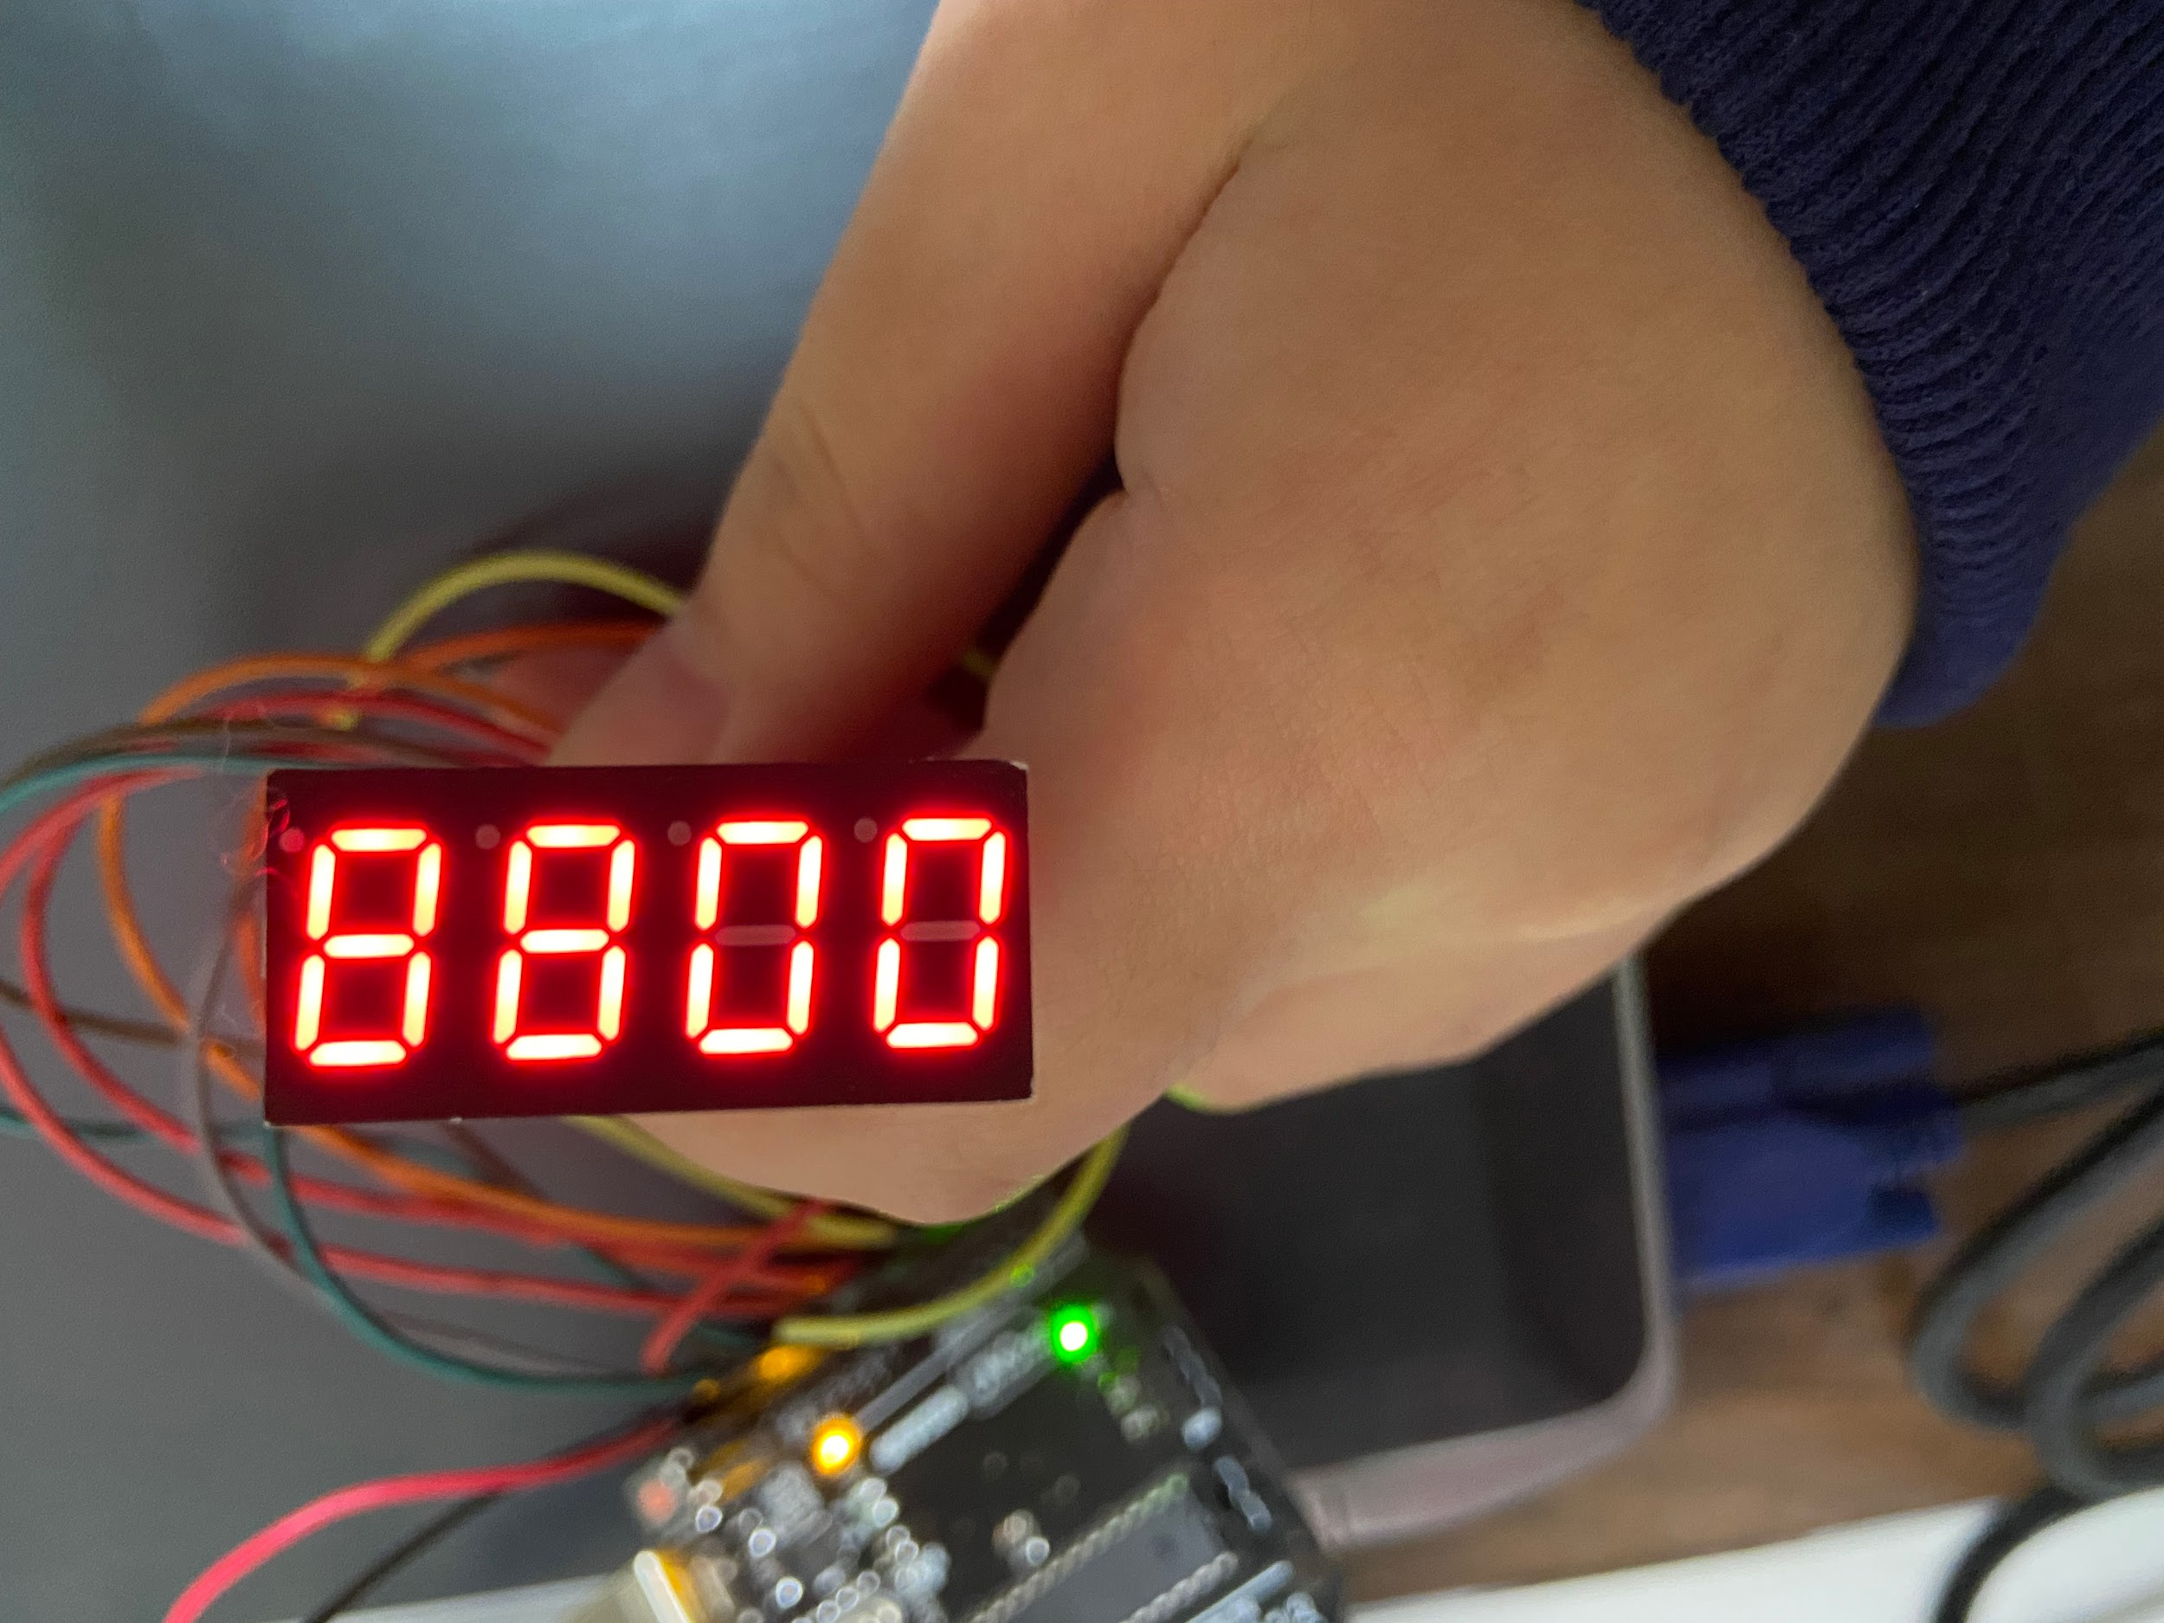
Servo- lock (control the state of the door (locked or unlocked) by changing its position)
4 digit 7 segment display - countdown display, when the time reaches 0, the door will be locked.

Slide 8
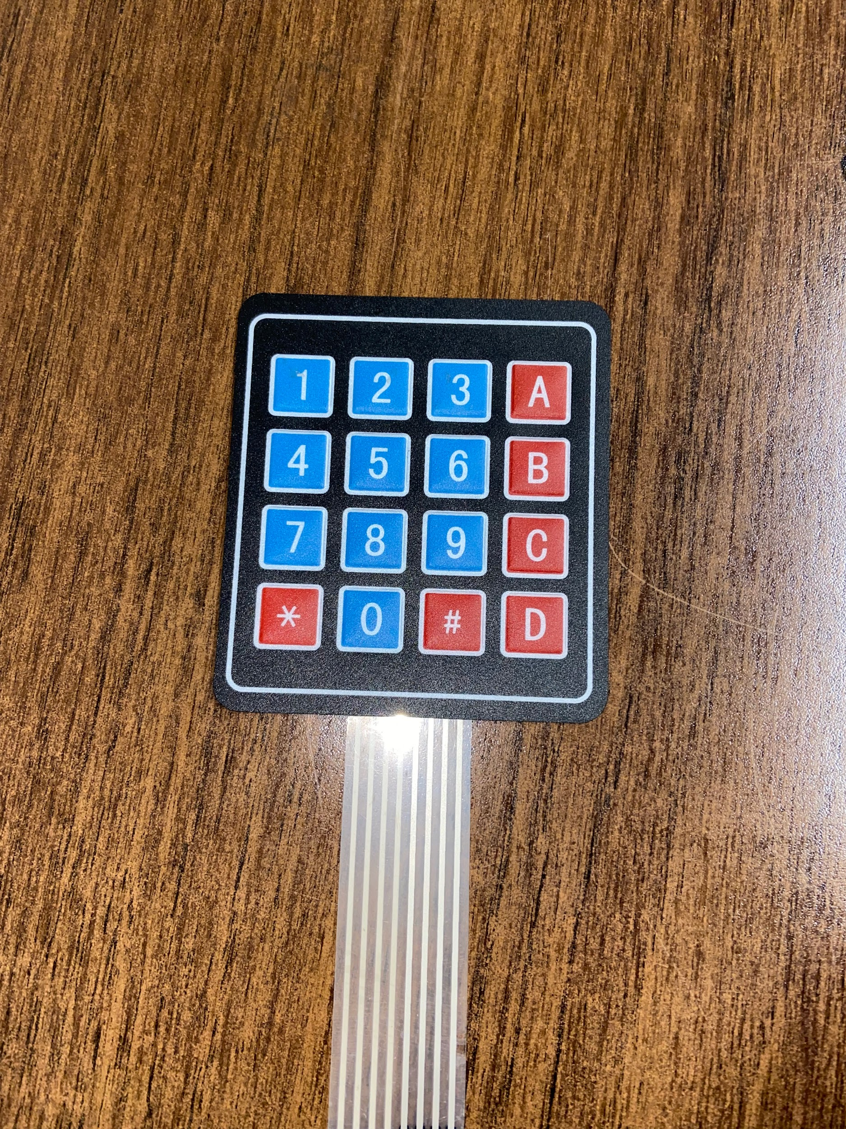
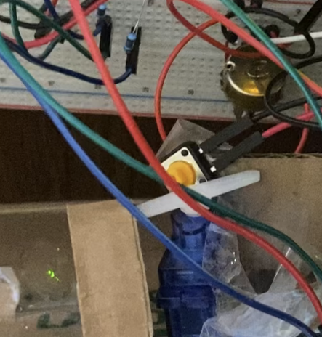
Keypad - enter and store the password
Button: Starts counting when the servo pushes it.

Slide 9
Code
Code
https://docs.google.com/document/d/1rx6ePXgDBQRyyAHYfl3PkY0G_uPPwHkjqHbM9CttnHI/edit?usp=sharing

Slide 10
References
https://create.arduino.cc/projecthub/SAnwandter1/programming-4-digit-7-segment-led-display-2d33f8(setting up the 4d7s display)
https://create.arduino.cc/projecthub/ronfrtek/4-digit-countdown-timer-minutes-and-seconds-arduino-86ef83(Timer code)
https://www.google.com/imgres?imgurl=https%3A%2F%2Fcdn.preferredsafe.com%2Fwp-content%2Fuploads%2F2017%2F11%2Fresidential-access-control.jpg&imgrefurl=https%3A%2F%2Fpreferredsafe.com%2Faccess-control-systems%2F&tbnid=KN__v21_vKMHvM&vet=12ahUKEwjxjI77iL70AhW-qnIEHVUrBvwQMygDegUIARC9AQ..i&docid=HZT8iU-W_fVSfM&w=900&h=600&itg=1&q=access%20control%20system%20password&ved=2ahUKEwjxjI77iL70AhW-qnIEHVUrBvwQMygDegUIARC9AQ (picture 1)
https://www.arduino.cc/reference/en/(programming)
https://create.arduino.cc/editor/mertarduinotech/9bc65c30-cca0-4849-902a-1bc5a300791c/preview (keypad code)

